Slide 1
Exploratory Data Analysis

Slide 2
Reasons
detection of mistakes
checking of assumptions
preliminary selection of appropriate models
determining relationships among the explanatory variables, and
assessing the direction and rough size of relationships between explanatory and outcome variables.

Slide 3
The basic tools of EDA are plots, graphs and summary statisitics.
Plotting distribution of variables
Plotting time series of data
Looking at pairwise relationships by using scatter plots.
Computing mean, minimum, maximum, the upper and lower quartiles and finding the OUTLIERS

Slide 4
People are not very good at looking at a column of numbers or a whole spread-sheet and then determining important characteristics of the data. They find looking at numbers to be tedious, boring, and/or overwhelming.

Slide 5
Exploratory data analysis is generally cross-classified in two ways.
Non-graphical or graphical. Non-graphical methods generally involve calculation of summary statistics. Graphical methods obviously summarize the data in a diagrammatic or pictorial way.
Univariate (look at one variable (data column) at a time) or multivariate (usually just bivariate) (look at two or more variables at a time to explore relationships.)

Slide 6
Although there are guidelines about which EDA techniques are useful in what circumstances, there is an important degree of looseness and art to EDA. Competence and confidence come with practice, experience, and close observation of others.

Slide 7
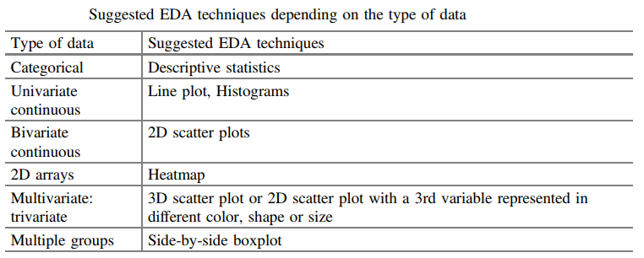

Slide 8
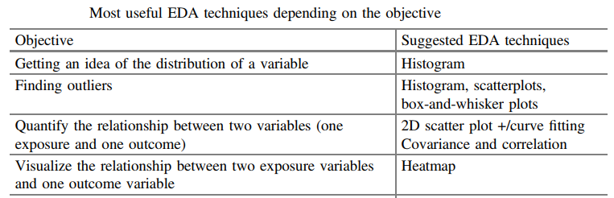

Slide 9
Univariate non-graphical EDA
Represent a “sample distribution" of the variable, which in turn more or less represents the “population distribution" of the variable.
The usual goal of univariate non-graphical EDA is to better appreciate the “sample distribution“ and also to make some tentative conclusions about what population distribution(s) is/are compatible with the sample distribution. Outlier detection is also a part of this analysis.

Slide 10
Categorical data
Categorical (aka, qualitative) or quantitative (aka, numerical).
Qualitative or categorical data have no logical order, and can't be translated into a numerical value. Eye colour is an example, because 'brown' is not higher or lower than 'blue'.
Quantitative or numerical data are numbers, and that way they 'impose' an order. Examples are age, height, weight.

Slide 11
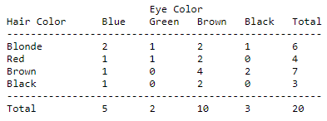
Qualitative
Categorical variables represent types of data which may be divided into groups.
Analysis of categorical data generally involves the use of data tables.
E.g. Hair color, eye color, course feedback

Slide 12
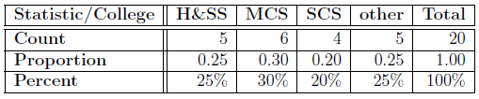

Slide 13
Nominal scales are used for labeling variables, without any quantitative value. “Nominal” scales could simply be called “labels.”
E.g. Gender, Hair color
There is no agreed way to order these from highest to lowest.
In Ordinal variables there is a clear ordering of the variables.
E.g. Education, Strictly disagree-Strictly agree

Slide 14
Quantitative
The characteristics of the population distribution of a quantitative variable are its center, spread, modality (number of peaks in the pdf), shape (including \heaviness of the tails"), and outliers.
Our observed data represent just one sample out of an infinite number of possible samples. The characteristics of our randomly observed sample are not inherently interesting, except to the degree that they represent the population that it came from. This would be different each time we might repeat the same experiment, due to selection of a different random sample. But sample statistics are generally thought of as estimates of the corresponding population parameters.

Slide 15
There is no generally recognized formal definition for outlier, but roughly it means values that are outside of the areas of a distribution that would commonly occur. This can also be thought of as sample data values which correspond to areas of the population pdf (or pmf) with low density (or probability).
Another common definition of “outlier" consider any point more than a fixed number of standard deviations from the mean to be an “outlier"

Slide 16
For quantitative variables (and possibly for ordinal variables) it is worthwhile looking at the central tendency, spread, skewness, and kurtosis of the data for a particular variable from an experiment. But for categorical variables, none of these make any sense.

Slide 17
Central tendency
The central tendency or “location" of a distribution has to do with typical or middle values. The common, useful measures of central tendency are the statistics called (arithmetic) mean, median, and sometimes mode.

Slide 18
Mean
For any symmetrically shaped distribution (i.e., one with a symmetric histogram or pdf or pmf) the mean is the point around which the symmetry holds.
For non-symmetric distributions, the mean is the “balance point": if the histogram is cut out of some homogeneous stiff material such as cardboard, it will balance on a fulcrum placed at the mean.

Slide 19
For a fixed finite population or for a theoretic infinite population described by a pmf or pdf, there is a single population mean which is a fixed, often unknown, value called the mean parameter
On the other hand, the “sample mean" will vary from sample to sample as different samples are taken, and so is a random variable. The probability distribution of the sample mean is referred to as its sampling distribution.

Slide 20
Median
The sample median is the middle value after all of the values are put in an ordered list.
List: 3, 13, 2, 34, 11, 26, 47
Arranged in order, the list becomes: 2, 3, 11, 13, 26, 34, 47
The median is the number in the middle: 2, 3, 11, 13, 26, 34, 47

Slide 21
If there are an even number of values, take the average of the two middle values.
List: 3, 13, 2, 34, 11, 26, 47, 17
Arranged in order, the list becomes: 2, 3, 11, 13, 17, 26, 34, 47
The median is the average of the two numbers in the middle: 2, 3, 11, 13, 17, 26, 34, 47
13 + 17 = 30 30/ 2 = 15.

Slide 22
For symmetric distributions, the mean and the median coincide.
For unimodal skewed (asymmetric) distributions, the mean is farther in the direction of the “pulled out tail" of the distribution than the median is.
For many cases of skewed distributions, the median is preferred as a measure of central tendency.
The median has a very special property called robustness. A sample statistic is “robust" if moving some data tends not to change the value of the statistic. The median is highly robust, because you can move nearly all of the upper half and/or lower half of the data values any distance away from the median without changing the median. More practically, a few very high values or very low values usually have no effect on the median.

Slide 23
Mode
The most likely or frequently occurring value.
“mode“ describes whether a distribution has a single peak (unimodal) or two or more peaks (bimodal or multi-modal).
In symmetric, unimodal distributions, the mode equals both the mean and the median.

Slide 24
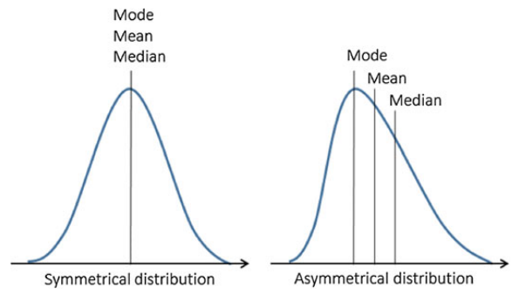
The most common measure of central tendency is the mean. For skewed distribution or when there is concern about outliers, the median may be preferred.

Slide 25
Spread
Spread can be measure by variance, standard deviation, and interquartile range.
Spread is an indicator of how far away from the center we are still likely to find data values.

Slide 26

Variance
The variance is a standard measure of spread.
It is calculated for a list of numbers, e.g., the n observations of a particular measurement labeled x1 through xn, based on the n sample deviations (or just “deviations").
For any data value, xi, the corresponding deviation is (xi – x(mean)), which is the signed (- for lower and + for higher) distance of the data value from the mean of all of the n data values.
The variance of a population is defined as the mean squared deviation.

Slide 27
Standard Deviation
The standard deviation is simply the square root of the variance.
Because of the square, variances are always non-negative, and they have the somewhat unusual property of having squared units compared to the original data.
But s.d. has the same units as the original data, which helps make it more interpretable.
For a theoretical Gaussian distribution, mean plus or minus 1, 2 or 3 standard deviations holds 68.3, 95.4 and 99.7% of the probability respectively, and this should be approximately true for real data from a Normal distribution.

Slide 28
So in summary:
The variance and standard deviation are two useful measures of spread. The variance is the mean of the squares of the individual deviations. The standard deviation is the square root of the variance.
For Normally distributed data, approximately 95% of the values lie within 2 s.d. of the mean.

Slide 29
Interquartile range (IQR)
The quartiles of a population or a sample are the three values which divide the distribution or observed data into even fourths.
One quarter (25%) of the data fall below the first quartile, (Q1);
one half (50%) fall below the second quartile (Q2); (Q2 is median)
and three fourths (75%) fall below the third quartile (Q3).
IQR = Q3 - Q1.
If the data are more spread out, then the IQR tends to increase, and vice versa.

Slide 30
The IQR is a more robust measure of spread than the variance or standard deviation. Any number of values in the top or bottom quarters of the data can be moved any distance from the median without affecting the IQR at all. More practically, a few extreme outliers have little or no effect on the IQR.

Slide 31
Range of data
maximum – minimum
May be used for scaling.

Slide 32
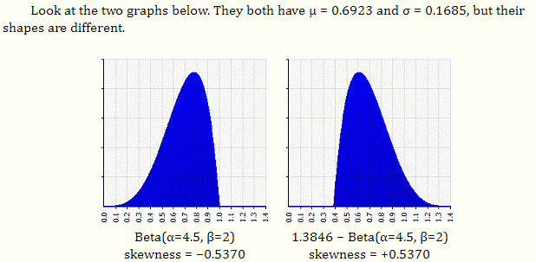
https://brownmath.com/stat/shape.htm

Slide 33

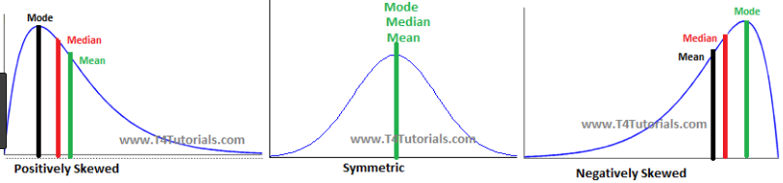
Skewness
Skewness is a measure of asymmetry.

Slide 34
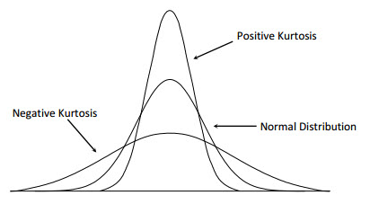

Kurtosis
Kurtosis is a more subtle measure of peaked-ness compared to a Gaussian distribution.

Slide 35
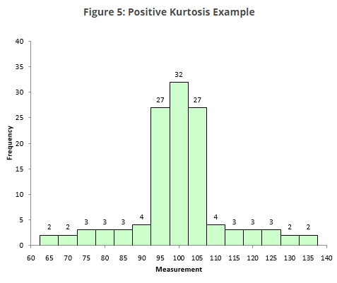

Slide 36
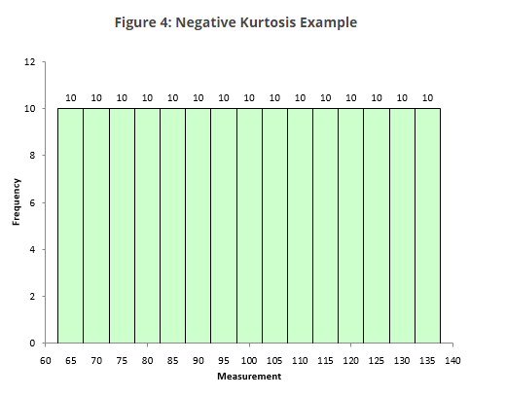

Slide 37
Higher kurtosis is the result of infrequent extreme deviations (or outliers), as opposed to frequent modestly sized deviations

Slide 38
Univariate graphical EDA

Slide 39
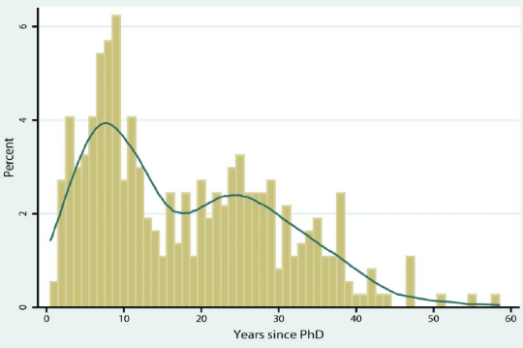
Histograms

Slide 40
Histograms
The most basic graph is the histogram, which is a barplot in which each bar represents the frequency (count) or proportion (count/total count) of cases for a range of values.
Typically the bars run vertically with the count (or proportion) axis running vertically. To manually construct a histogram, define the range of data for each bar (called a bin), count how many cases fall in each bin, and draw the bars high enough to indicate the count.
Generally you will choose between about 5 and 30 bins, depending on the amount of data.
It is often worthwhile to try a few different bin sizes/numbers because, especially with small samples, there may sometimes be a different shape to the histogram when the bin size changes.

Slide 41
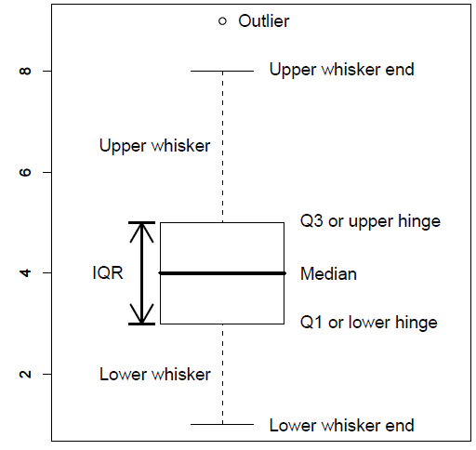
Boxplot (Box and whiskers)

Slide 42
Boxplot (Box and whiskers)
Boxplots are very good at presenting information about the central tendency, symmetry and skew, as well as outliers, although they can be misleading about aspects such as multimodality. One of the best uses of boxplots is in the form of side-by-side boxplots

Slide 43
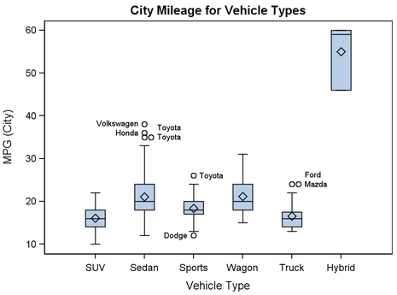

Slide 44
Any data value more than 1.5 IQRs beyond its corresponding hinge in either direction is considered an “outlier" and is individually plotted. Sometimes values beyond 3.0 IQRs are considered “extreme outliers" and are plotted with a different symbol.
Each whisker is drawn out to the most extreme data point that is less than 1.5 IQRs beyond the corresponding hinge. Therefore, the whisker ends correspond to the minimum and maximum values of the data excluding the “outliers".
Important: The term “outlier" is not well defined in statistics, and the definition varies depending on the purpose and situation.

Slide 45
Boxplots are excellent EDA plots because they rely on robust statistics like median and IQR rather than more sensitive ones such as mean and standard deviation. With boxplots it is easy to compare distributions

Slide 46
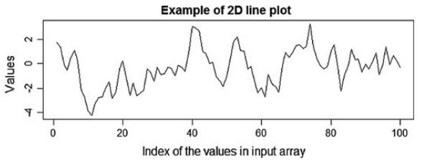
2D line plot

Slide 47
Multivariate non-graphical EDA
Multivariate non-graphical EDA techniques generally show the relationship between two or more variables in the form of either cross-tabulation or statistics.

Slide 48

Cross-tabulation
For categorical data (and quantitative data with only a few different values) an extension of tabulation called cross-tabulation is very useful.
For two variables, cross-tabulation is performed by making a two-way table with column headings that match the levels of one variable and row headings that match the levels of the other variable, then filling in the counts of all subjects that share a pair of levels.

Slide 49
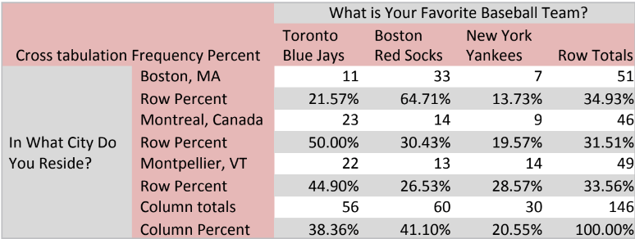
Cross-tabulation (cont…)

Slide 50
Cross-tabulation can be extended to three (and sometimes more) variables by making separate two-way tables for two variables at each level of a third variable.

Slide 51
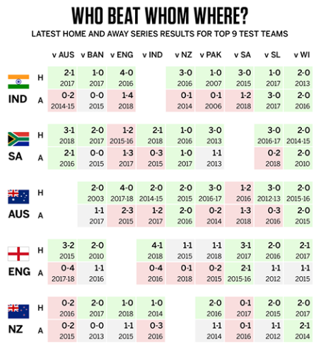

Slide 52
Univariate statistics by category (for multivariate)
For one categorical variable (usually explanatory) and one quantitative variable (usually outcome), it is common to produce some of the standard univariate non-graphical statistics for the quantitative variables separately for each level of the categorical variable, and then compare the statistics across levels of the categorical variable.
E.g.
Comparing the means.
Comparing medians
Comparing measures of spread

Slide 53
Correlation for categorical data
Another statistic that can be calculated for two categorical variables is their correlation.

Slide 54
Correlation and covariance
For two quantitative variables, the basic statistics of interest are the sample co-variance and/or sample correlation.
The sample covariance is a measure of how much two variables “co-vary", i.e., how much (and in what direction) should we expect one variable to change when the other changes.
Positive covariance values suggest that when one measurement is above the mean the other will probably also be above the mean, and vice versa.
Negative covariances suggest that when one variable is above its mean, the other is below its mean.
Covariances near zero suggest that the two variables vary independently of each other.

Slide 55
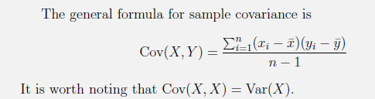

Slide 56
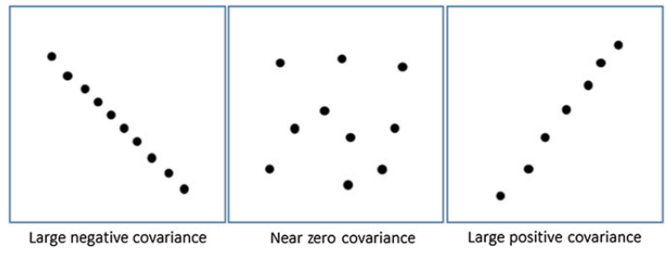

Slide 57

Covariances tend to be hard to interpret, so we often use correlation instead.
The correlation has the nice property that it is always between -1 and +1,
-1 being a “perfect" negative linear correlation, +1 being a perfect positive linear correlation
0 indicates that X and Y are uncorrelated.

Slide 58
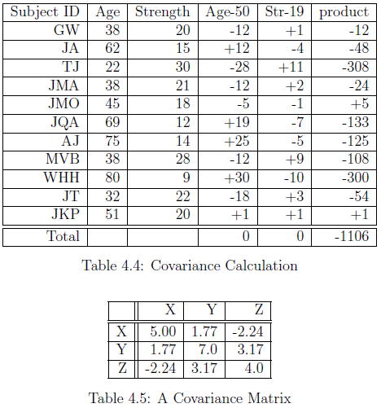
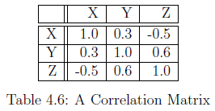

Slide 59
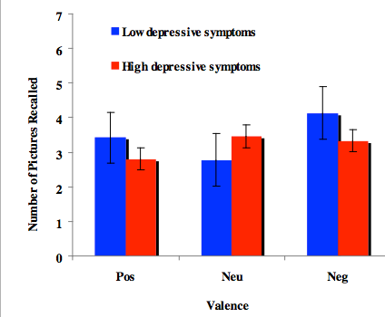
Univariate graphs by category

Slide 60
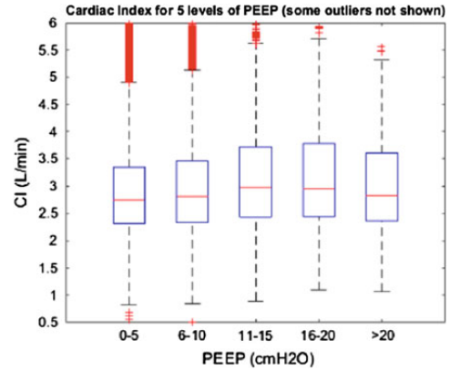
Side-by-Side Boxplots

Slide 61
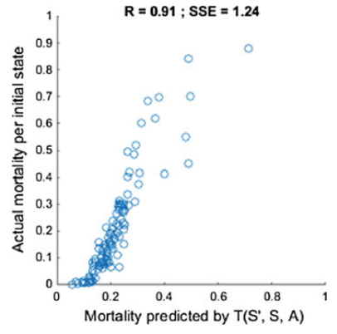
Scatterplots

Slide 62
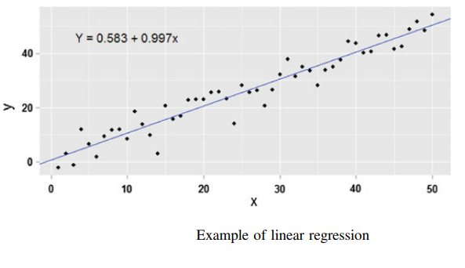
Curve fitting

Slide 63
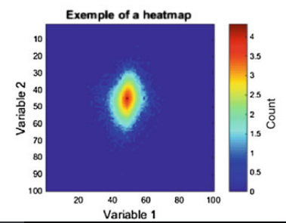
Heat maps

Slide 64
Heat maps (cont..)
Heat maps are simply a 2D grid built from a 2D array, whose color depends on the value of each cell. The data set must correspond to a 2D array whose cells contain the values of the outcome variable. This technique is useful when you want to represent the change of an outcome variable (e.g. length of stay) as a function of two other variables (e.g. age and SOFA score).

Slide 65
Pareto Analysis
The Pareto principle (also known as the 80-20 rule) applies to wide range of fields from natural science to sports.
80% of web traffic comes from 20% of your site’s pages.
80% of customer complaints are caused by 20% of product defects.
80% of revenue comes from 20% of your customers.

Slide 66
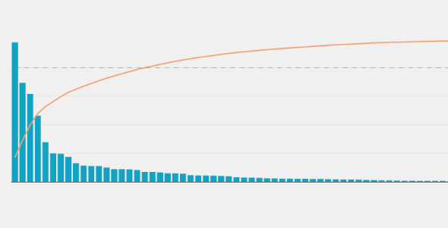
Pareto analysis

Slide 67
The Pareto chart is a visual representation of the 80-20 rule, featuring a bar + line chart. The bars represent the value of each item on your list (arranged in descending order), and the line indicates the cumulative percentage of those values.

Slide 68
Probability Distributions
If we measure and plot various real world processes, certain shapes appear again and again
These shapes can be approximated by mathematical functions with few parameters
We can use these shapes as building blocks of our models

Slide 69
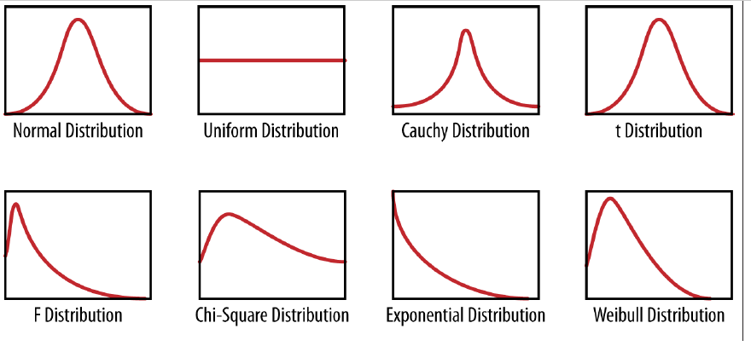
Probability Distributions

Slide 70
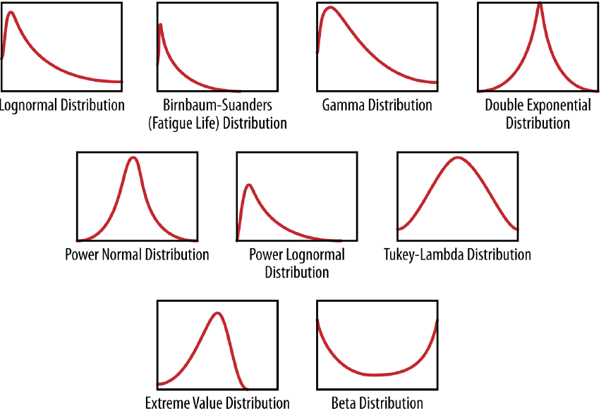
Probability Distributions

Slide 71
Probability Distributions
Probability distribution is foundation of statistical modeling
These shapes can often be approximated by mathematical functions
We can use these shapes as building blocks of our models
“A Probability distribution assigns a probability to a subset of possible outcomes”

Slide 72
References
http://www.stat.yale.edu/Courses/1997-98/101/catdat.htm
https://stattrek.com/statistics/dictionary.aspx?definition=categorical%20variable
https://socratic.org/questions/what-is-the-difference-between-categorical-qualitative-data-and-numerical-quanti
https://www.mymarketresearchmethods.com/types-of-data-nominal-ordinal-interval-ratio/
https://www.investopedia.com/
https://www.researchgate.net/publication/308007227_Exploratory_Data_Analysis
https://blog.modeanalytics.com/pareto-chart-101/
https://www.spcforexcel.com/knowledge/basic-statistics/are-skewness-and-kurtosis-useful-statistics
wikipedia

